Slide 1


I02: Interactive Online Learning Environment
Notes:
Hello everyone, my name is Giorgos Antoniou, I am a Project Manager at the Center for Social Innovation here in Cyprus and for SUM project our organization was leading the deliverable of designing and developing an interactive Online learning environment

Slide 2
IO2 - Methodology
Objective: delivery of all online learning components and interactive tools of the project.
3 components of IO2:
Interactive Online Learning Platform
Development and integration of learning tools, communication tools and multimedia content
Mobile Application

Slide 3
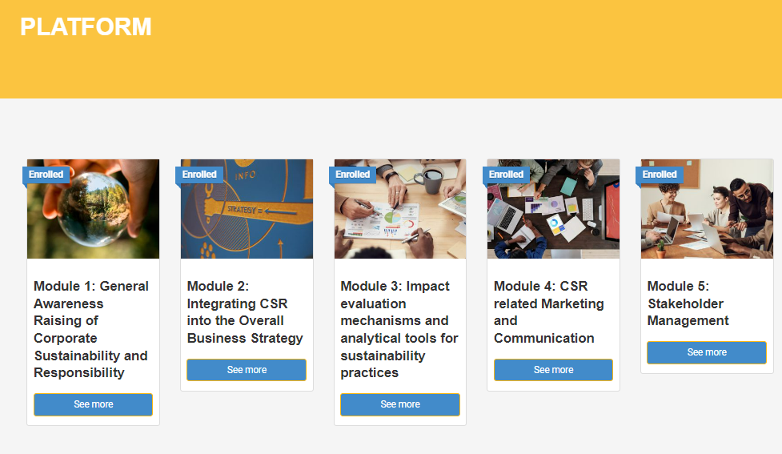
IO2 – Learning Platform
Overview
Interactive Learning platform includes
IO1 modules
Policy & Adaptation Guide

Slide 4
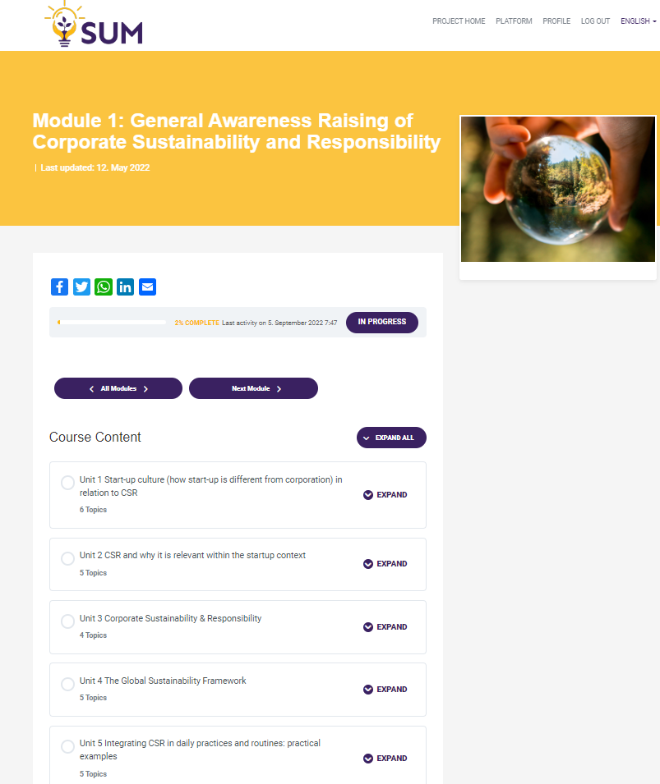
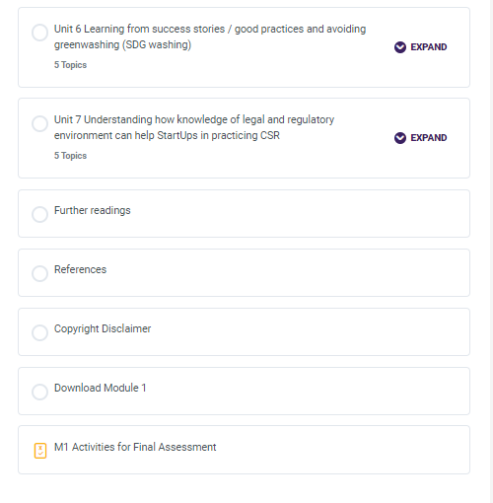
IO2 – Module Overview
Each Module contains of
Units and Topics
Modules -> Units -> Topics -> Module Assessment

Slide 5
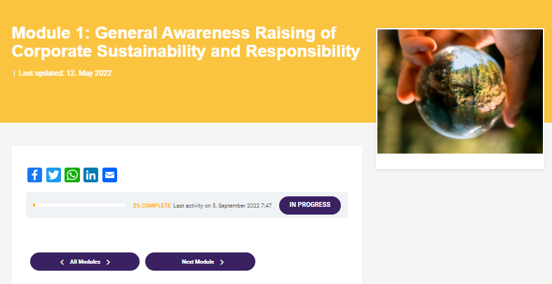
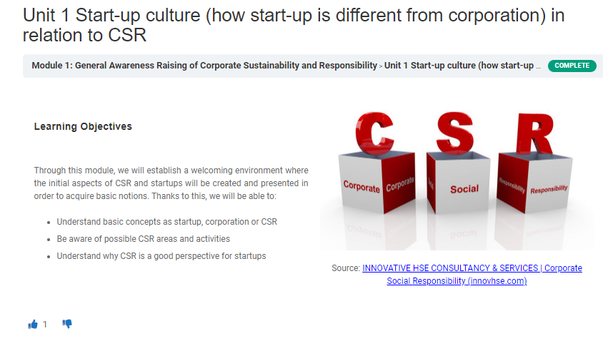
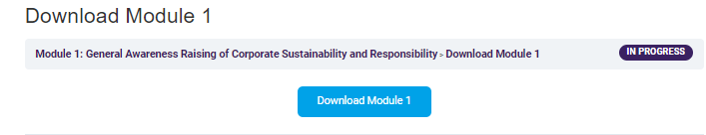

IO2 – Interactive Tools
Tracking Progress
Like / Dislike Buttons
Downloadable material
Comment Function

Slide 6

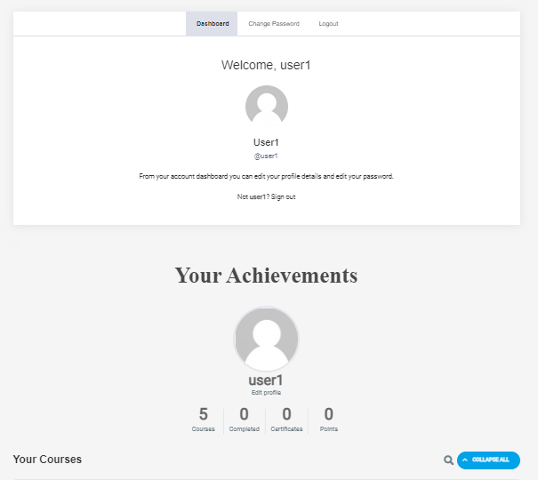
IO2 – Dashboard
Overview
Dashboard overview

Slide 7

IO2 – Digital Certificate
Digital Certificate –
at least 60% of all final assessment questions

Slide 8
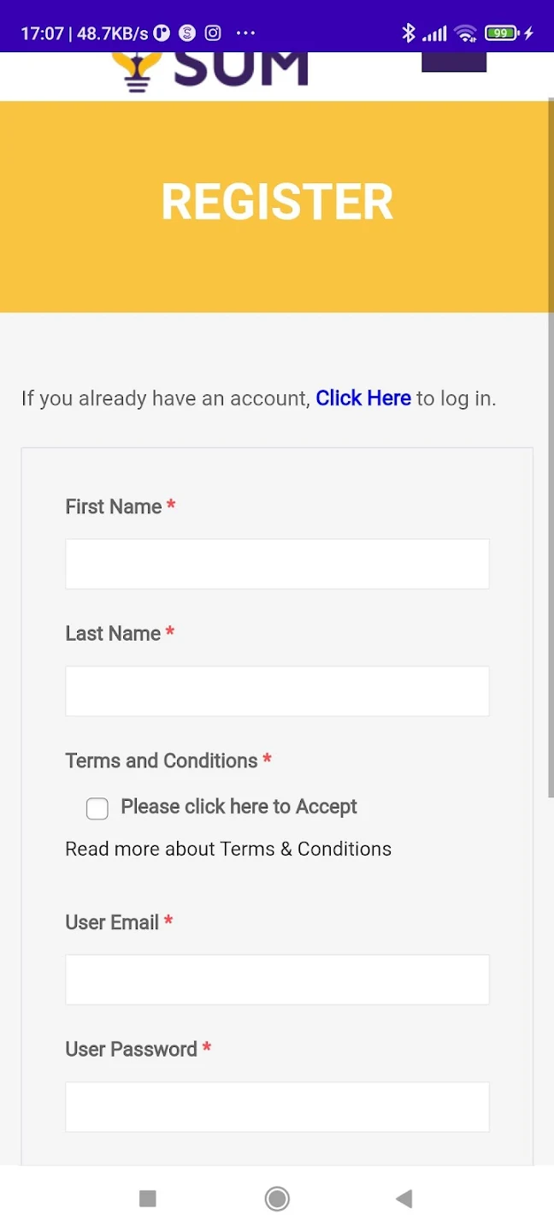
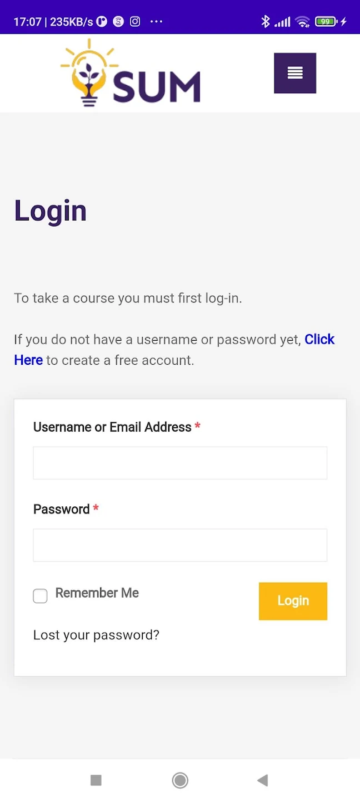
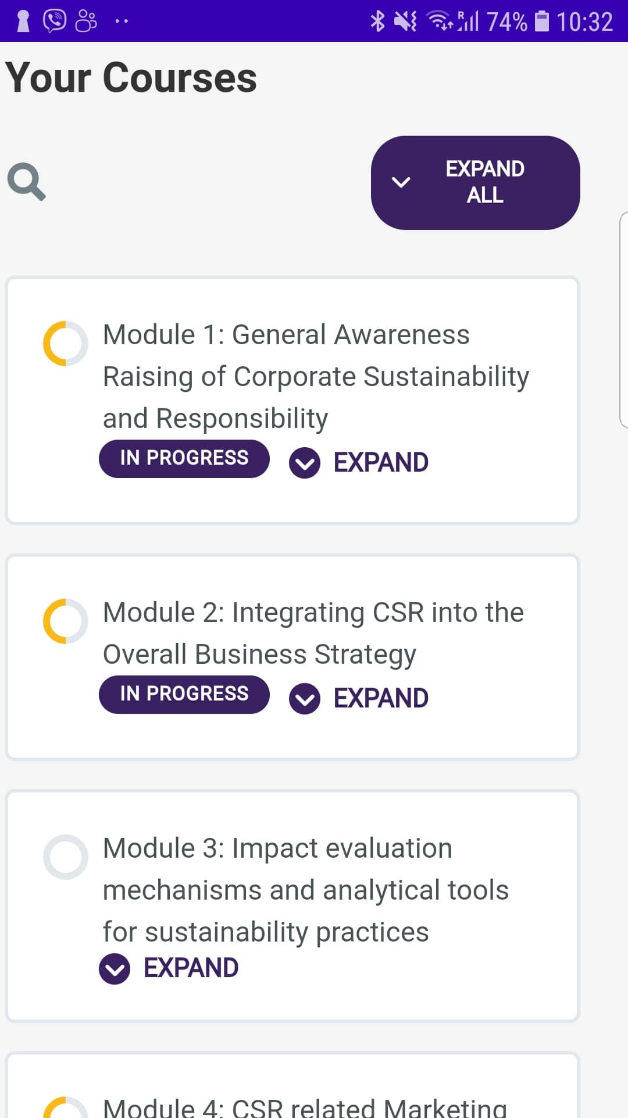
IO2 – Mobile Application
Mobile Application – available on Android devices

